Slide 1
HeadStart: Developing Financial Solutions for Small-scale Businesses
Abhiram S Nair (2348303)
Amogh DR (2348309)
Deependra Singh Rao (2348316)
John Jerry (2348330)
Prem T (2348363)
Under the guidance of:
Dr. Hemanth KS

Slide 2
Table of Contents
Abstract and Modules
Introduction
Problem Definition
Target Audience
Statistics
Case Study
Available Solutions
Components of Study
System Requirements
Progress Report

Slide 3
Abstract and Modules
The "Market Analysis" web application, HeadStart, empowers users with real-time financial insights. It aggregates and analyzes key economic indicators, market news, sector-specific data, and risk assessments, enabling informed decision-making. Target users are financial analysts, investors, corporate decision-makers, and financial institutions. Leveraging advanced data science techniques, "Market Analysis" simplifies complex financial landscapes, enhancing decision-making and operational efficiency.
- Key features include:
Economic Indicators: Interactive dashboards displaying vital metrics
Market News: Sector-wise news from reputable sources
Sector/Company Analysis: In-depth performance metrics and forecasts
Risk Analysis: Personalized assessments using historical and current data
AI Chat Bot: 24/7 support and insights

Slide 4
Introduction Stock Market, Stocks & Investments

Slide 5
Problem Definition
Defined problems:
Data Fragmentation
Heavy Time Consumption
High Overall Risk
Media Search and Literature Review
Identifying Gaps and Problems
Keyworks:
Data Fragmentation: when an organization's data becomes spread across different systems, applications, and storage locations. While the data may function as intended for individual tasks, its dispersed, siloed nature can make it more difficult to manage, analyze, and integrate effectively
Who is facing
Available Solutions
How are they affected

Slide 6

Who, How and Statistics
Who is facing the problems
Startups
Small-scale businesses
Some Big Companies
How are they affected
Too much time wasted on Data Compiling
Platforms like AWS and other Cloud Services are too expensive and smaller businesses cannot afford them
Companies, depending on their size spend weeks to months analysis potential stock investment and growth rate

Slide 7
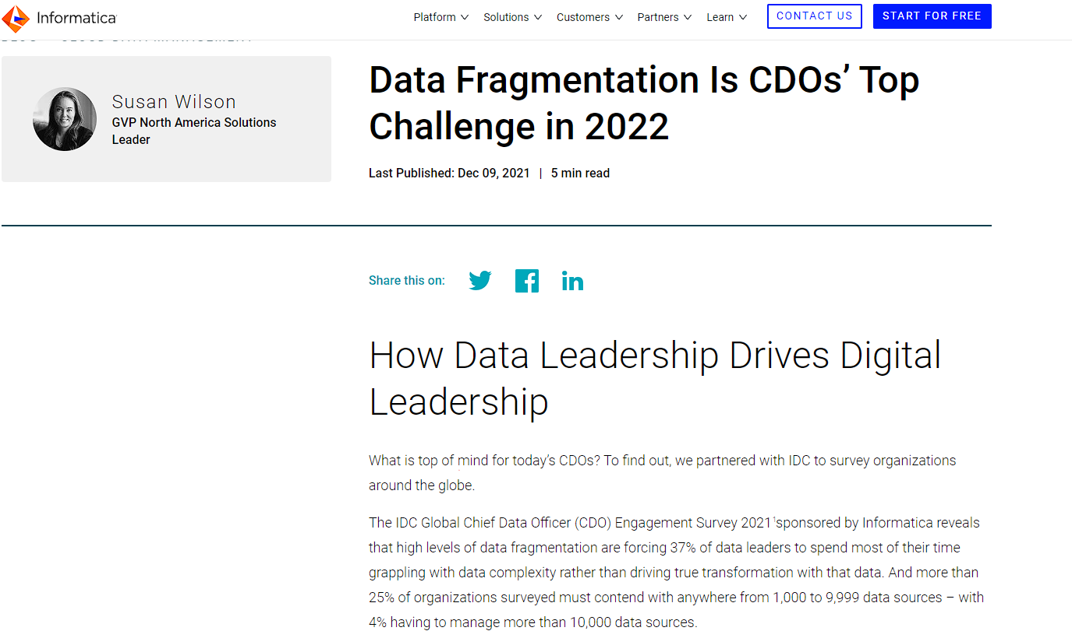
Who, How and Statistics (Continued)
How many are affected
The IDC Global Chief Data Officer (CDO) Engagement Survey 2021 sponsored by Informatica reveals that high levels of data fragmentation are forcing:
37% of data leaders to spend most of their time grappling with data complexity.
25% of organizations must contend with anywhere from 1,000 to 9,999 data sources
4% having to manage more than 10,000 data sources
An average of 20-30% of their time searching for and consolidating information
According to a report by Deloitte, 60% of financial services firms struggle with regulatory compliance due to fragmented and siloed data systems.
Sources: Informatica Blog, etc.

Slide 8


Case Study – Netflix & PayPal When, Issues & Solutions

Slide 9
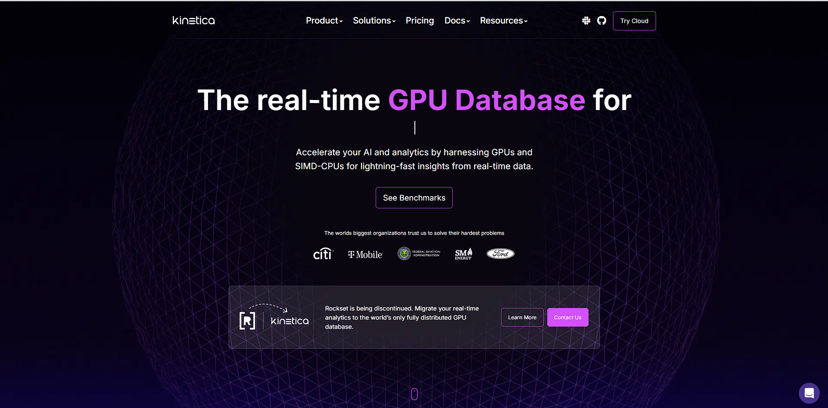
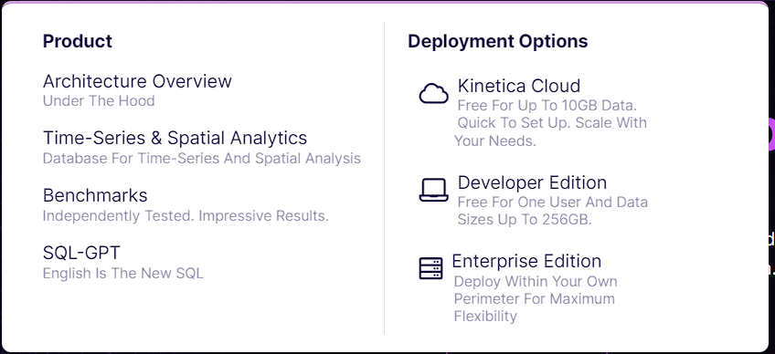
Available Solutions: Kinetica Third Party, Uses AI & Less Flexible

Slide 10
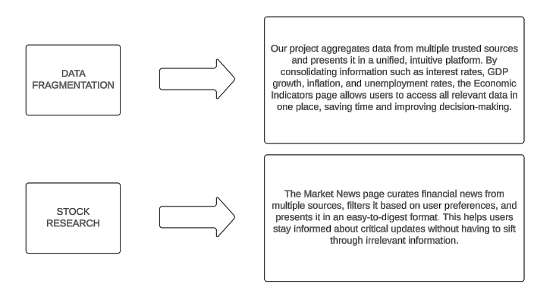
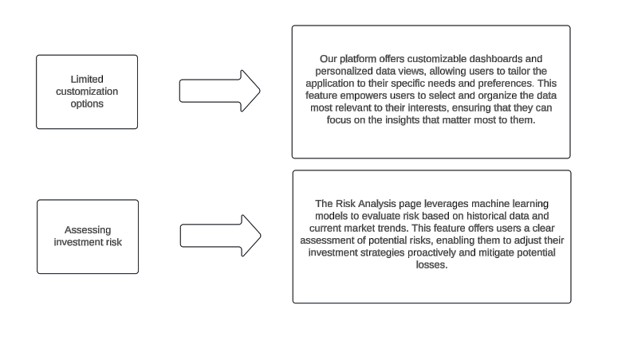
Proposed Solutions

Slide 11
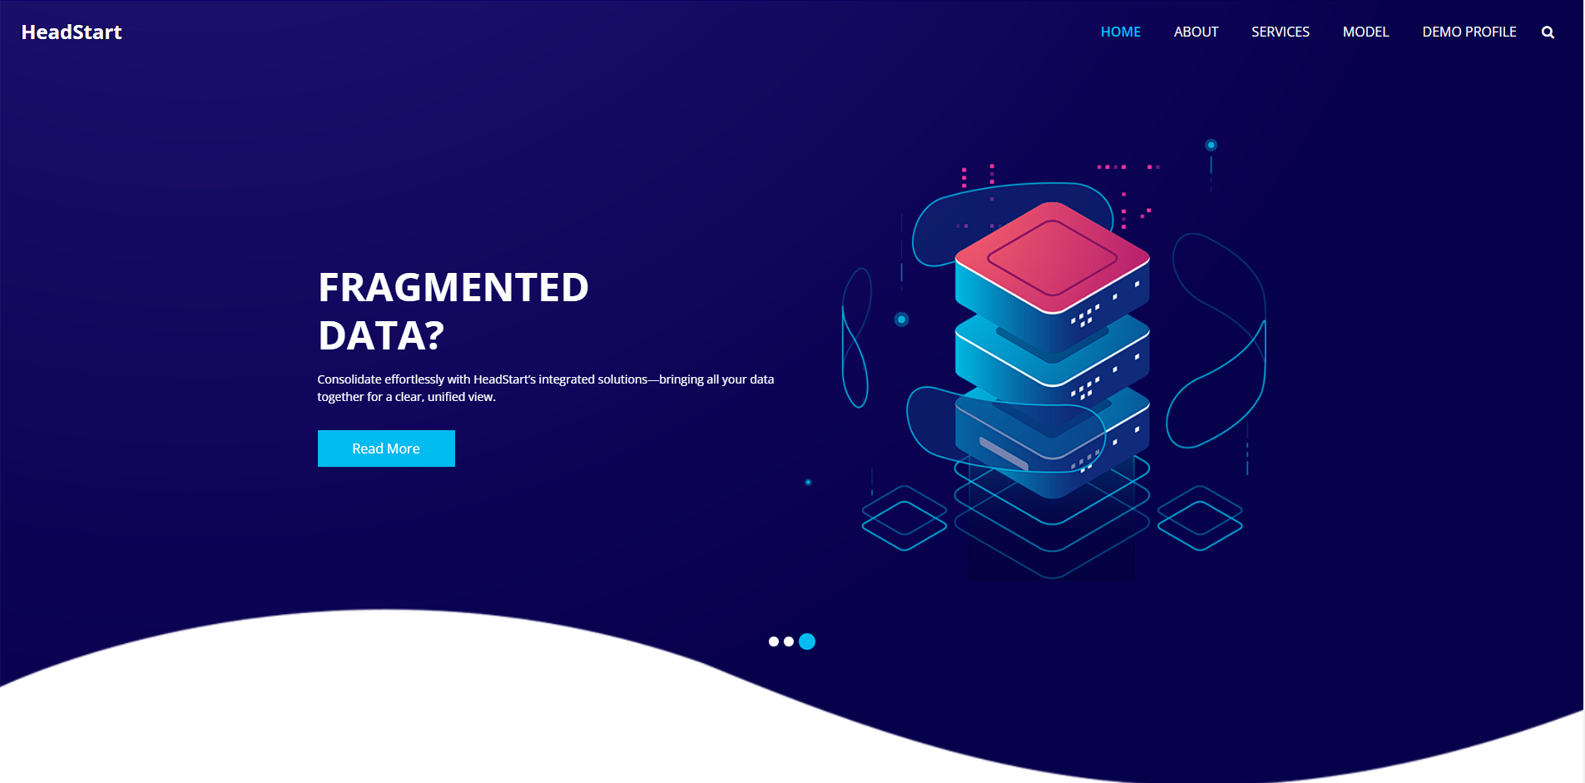
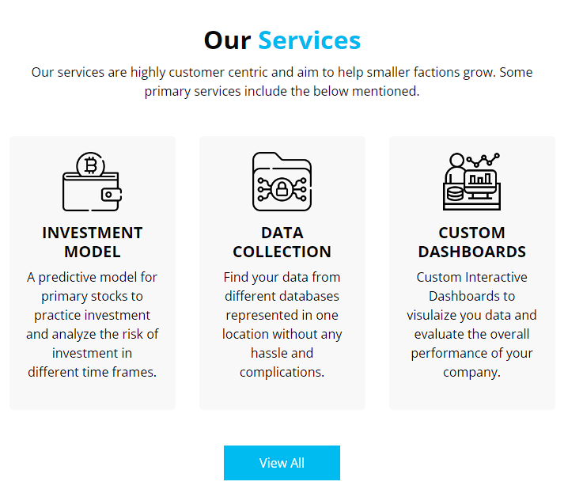
User Interface Design

Slide 12
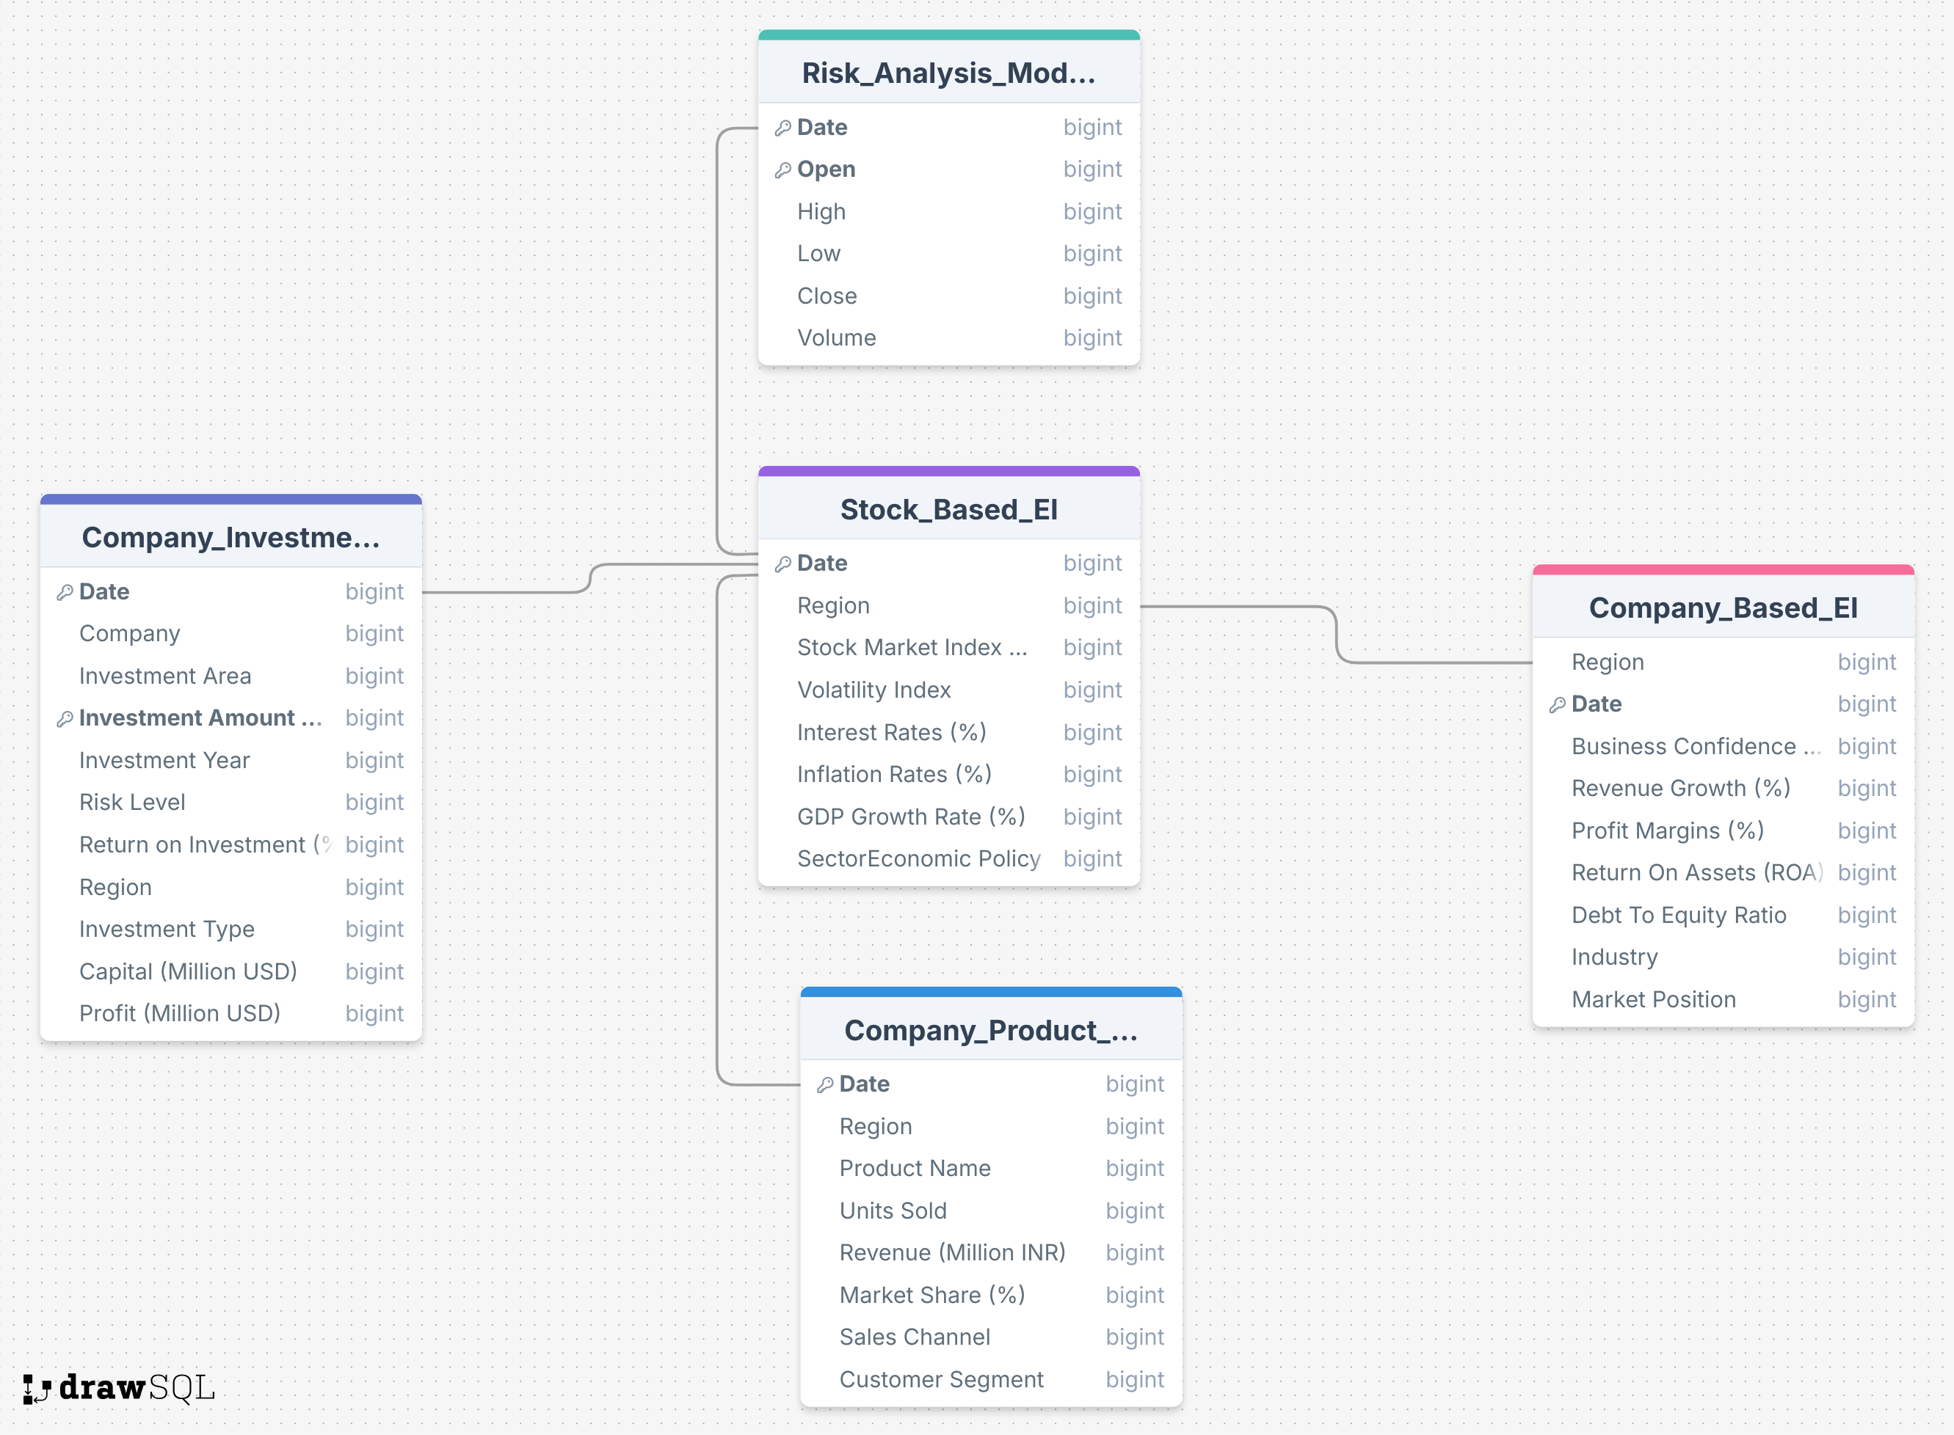
Database
Sources: Yahoo finance, World Economic Outlook, etc.

Slide 13
Economic Indicators
Indicators: A real-time dashboard displaying key economic metrics such as volatility index, stock market index, interest rates, GDP growth, inflation, and more. Users can customize their views based on specific market interests, ensuring they receive relevant data
Sector/Company Analysis: Detailed insights into company performance, market share, and investment analysis (Business Confidence Index, Revenue Growth, Profit Margins, ROA, Debt to Equity Ratio). This page includes visualizations and predictive models that aid in decision-making

Slide 14
Managing Market News
Challenge: Staying updated with financial news is overwhelming due to the sheer volume of information available daily
Traditional Approach: Method: Subscribing to newspapers, magazines, and financial news services. Drawback: Time-consuming and leads to information overload
How We Simplify Financial News: Aggregation Filtering Summarization Daily Updates

Slide 15
Assessing Investment Risks
Challenges with Traditional Methods:
Historical Data: Provides insights but may not capture new market dynamics or unforeseen events
Financial Statements: Useful for evaluating financial health but can be slow and may miss recent market trends
Experience and Intuition: Personal judgment is valuable but might not fully account for rapid market changes
Limitation of Traditional Methods:
Heavy Time Consumption: Analyzing past performance and financial statements can be slow

Slide 16
Chatbot
Our financial insights platform includes a responsive chatbot, designed to assist users in navigating the site and accessing key financial data effortlessly. The chatbot is built using Google’s Dialogflow, a powerful natural language understanding platform, enabling real-time user interaction.
Key Features:
Interactive User Experience: The chatbot provides instant responses to user queries, guiding them through various sections like Economic Indicators, Market News, and Risk Analysis.
Natural Language Processing: Utilizes NLP to understand and respond to user input in a conversational manner.
Custom Intents: Specifically designed to handle financial-related inquiries, making it easier for finance professionals to get the insights they need.
Technical Integration:
The chatbot is embedded directly into the website via Dialogflow’s Web Demo integration..
Benefits:
Efficiency: Reduces the need for manual navigation, allowing users to quickly find relevant information.
User Engagement: Enhances user interaction with the platform, leading to a more engaging and supportive user experience.
Scalability: Easily expandable to include additional functionalities and intents as the platform grows.

Slide 17
System Requirements Development
Hardware:
● Processor: Intel Core i5 or equivalent
● RAM: 8 GB
● Storage: 250 GB SSD
● Network: High-speed internet connection with at least 10 Mbps upload/download speed
Software:
● Operating System: Linux (Ubuntu 20.04 LTS or later) or Windows Server 2016 or later
● Web Server: Apache HTTP Server 2.4 or Nginx 1.18
● Database: MySQL 8.0
● Programming Languages: Python 3.8 or later, JavaScript (Node.js 14 or later)
● Frameworks and Libraries: Django 3.2 or Flask 2.0 for backend.

Slide 18
System Requirements Client Side
Client-Side Minimum Requirements
Hardware:
● Processor: Intel Core i3 or equivalent
● RAM: 4 GB
● Storage: 100 GB HDD
● Display: 1024x768 resolution or higher
● Network: High-speed internet connection with at least 5 Mbps download speed
Software:
● Operating System: Windows 10, macOS 10.15, or a modern Linux distribution
● Web Browser: Latest versions of Chrome, Firefox, Safari, or Edge
● Others: JavaScript enabled, Cookies enabled

Slide 19
Work Flow Diagram
Problem Identification and Background Study
Data Collection
Database Creation
Visualization
Frontend Development
Risk Model Development
Integration
Deployment
SQL
Power BI
HTML, CSS, and JS
LSTM
Django or Ducdb

Slide 20
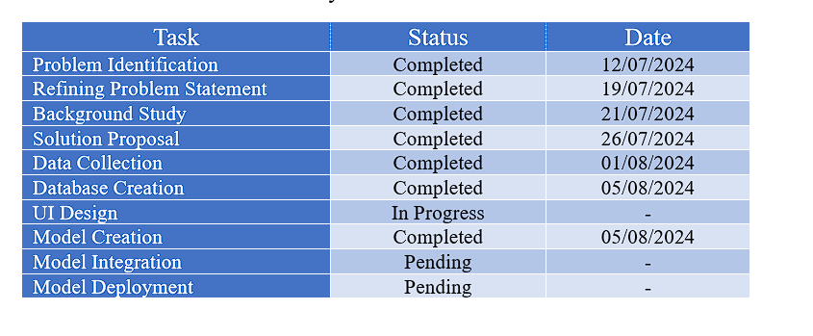
Progress Report

Slide 21
Thank You

